Slide 1

PMI
Talent Triangle
Evolving to Meet Our Expanding Portfolio and the Needs of the Marketplace

Slide 2
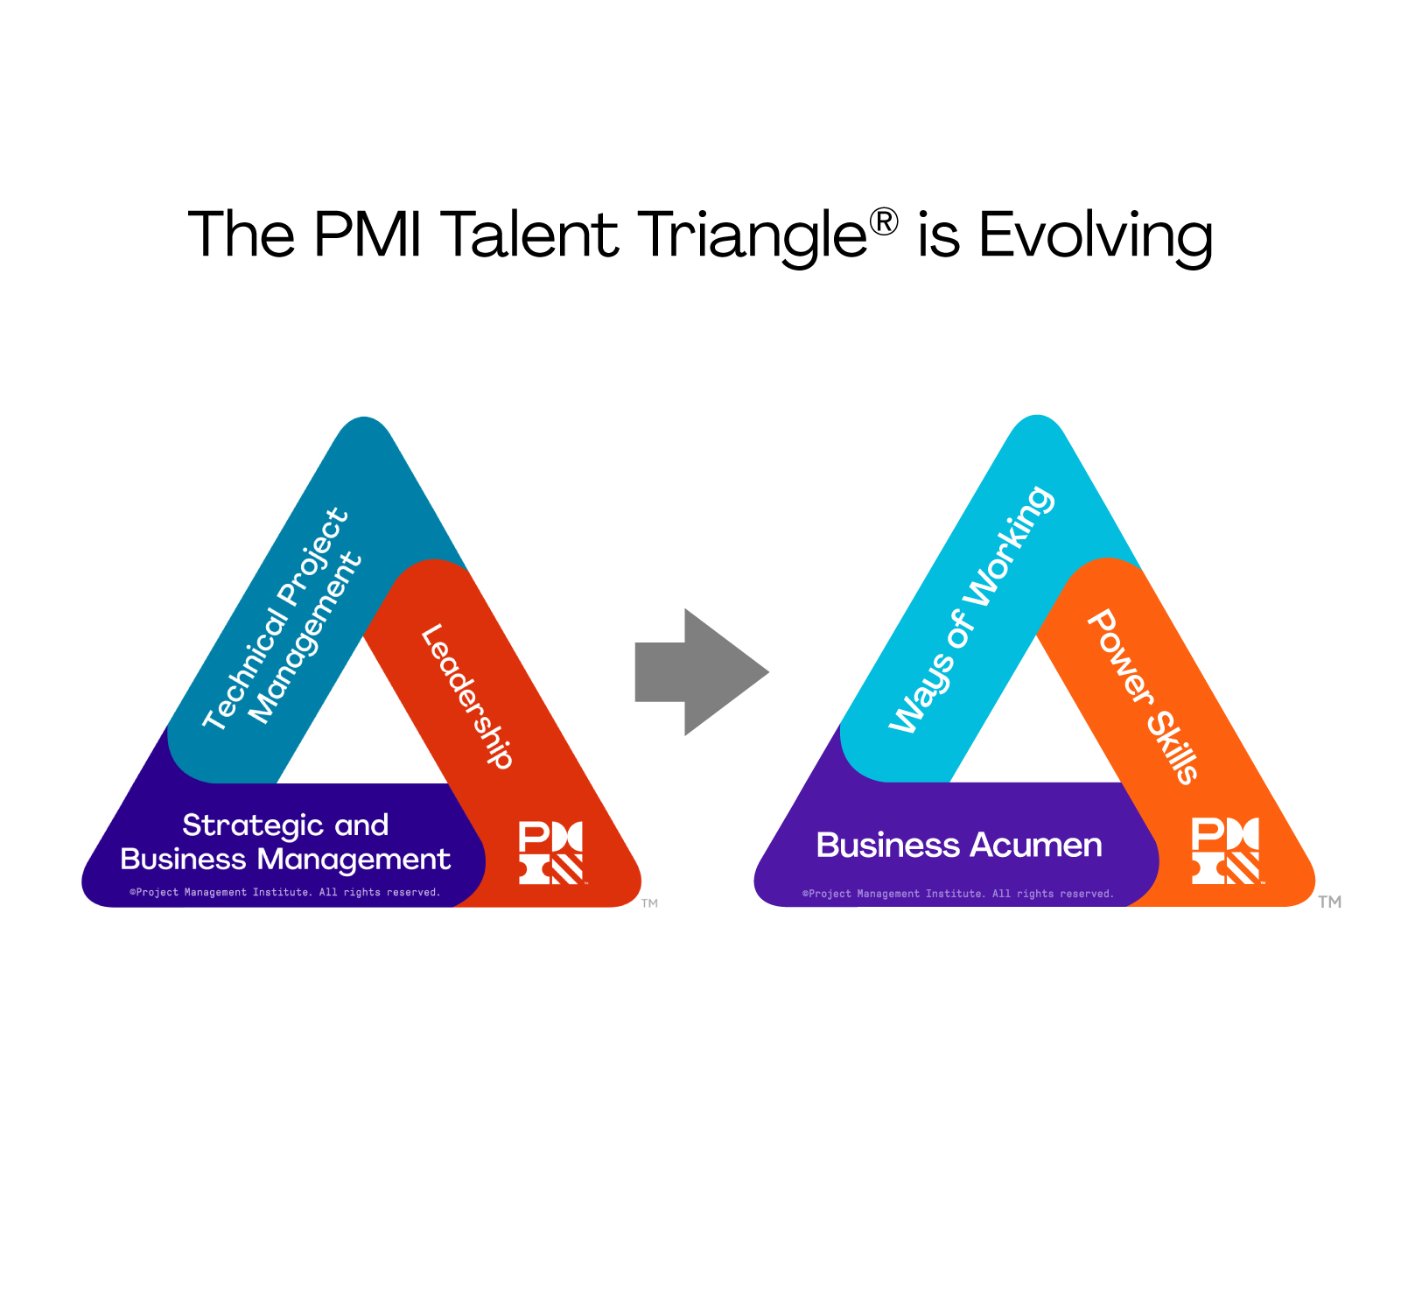

Evolving the PMI Talent Triangle
We are excited to announce the refreshed PMI Talent Triangle!
For those of you who may be new to PMI or are unfamiliar with the Talent Triangle:
The Talent Triangle represents the ideal sets of skills project professionals must develop to be successful in the world of project management.
This update ensures that the Talent Triangle reflects the skills needed by today’s project professionals and changemakers as they navigate the landscape of today.
Original PMI Talent Triangle

Slide 3

Why is PMI making this change?
Through research and listening to our stakeholders, we know that today’s projects demand a broad set of skills and capabilities. The former elements of the PMI Talent Triangle didn’t address all of our new offerings, while the new elements are inclusive of the tools and insights professionals need to develop new skills and tackle project challenges.
Re-skilling and upskilling employees with the combination of Ways of Working, Power Skills and Strategic Business Acumen will empower project professionals and their teams to make good decisions, have influence with different stakeholder groups, and choose the best way of working for any given situation.
This update to the PMI Talent Triangle will help professionals to lean into the skills and competencies they need for success, and navigate our profession’s ever-evolving landscape with confidence.
•
2 May 2022
3

Slide 4
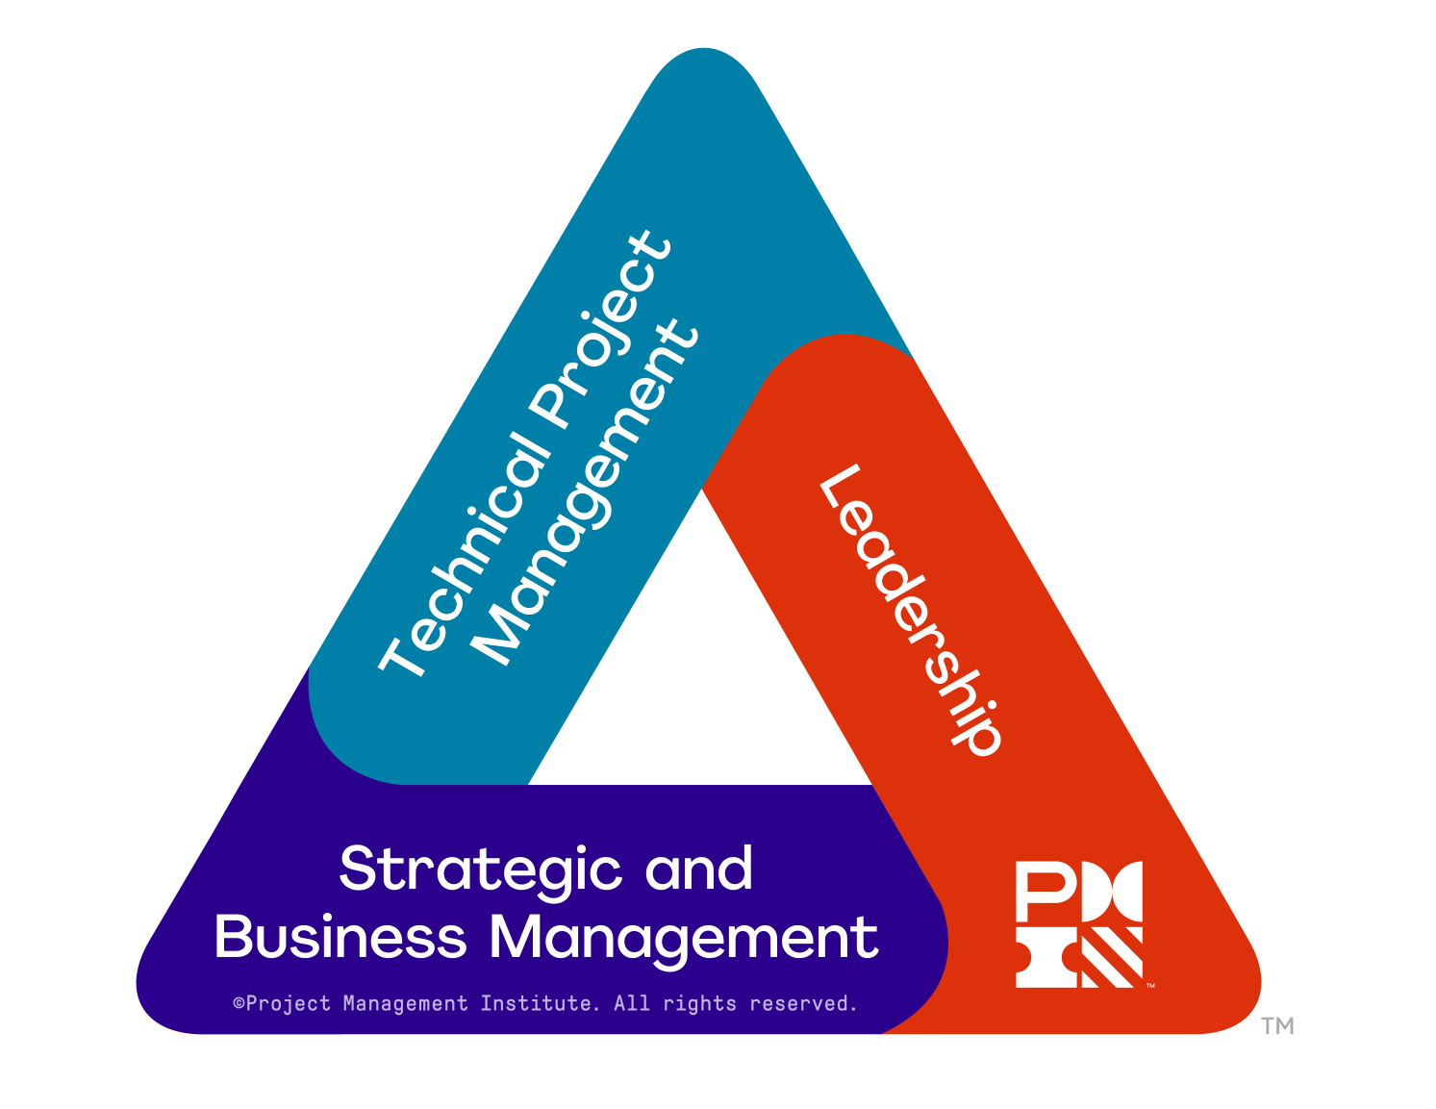
Evolving the PMI Talent Triangle
Like many great ideas, the PMI Talent Triangle® began as a sketch on the back of a napkin. When the idea was refined and officially launched, the intention was to change the mindset that managing projects was only a technical skillset. Instead, for practitioners to stay relevant and competitive, their skillset needed to include a combination of:
• Technical Project Management
• Leadership
• Strategic and Business Management
PDU requirements were tied to the Talent Triangle, and the graphic became an iconic symbol of both certification requirements and PMI offerings.
Original PMI Talent Triangle

Slide 5
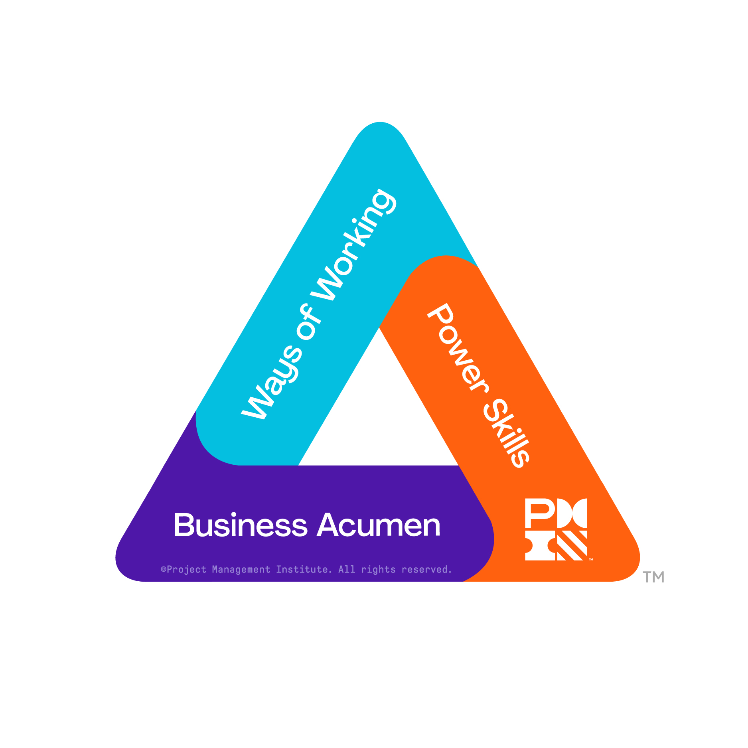
Updated PMI Talent Triangle
Since the introduction of the Talent Triangle, PMI has evolved. In addition to a new brand, PMI has embraced a wide variety of approaches and skillsets, and has adopted a new strategic focus for creating 10x impact and driving change. At the same time, the world has seen dramatic changes in ways of working and delivering results.
To help project professionals navigate this changing world of work and embrace smarter ways of working, we’ve made the following changes:
The Technical Project Management side will be replaced with “Ways of Working”
The Strategic and Business Management side will be replaced with “Business Acumen”
The Leadership side will be replaced with “Power Skills”
New PMI Talent Triangle

Slide 6


Ways of Working
Where Technical Project Management might have felt limiting to people who do not consider themselves project managers, Ways of Working makes it clear that there is more than one way that work gets done today.
Think of this category as mastering diverse and creative ways to get any job done
We encourage understanding and adopting many ways of working so we can quickly shift approaches as new challenges arise, to apply the right solutions, at the right time

Slide 7

Power Skills
Leadership is an essential skill set for any professional, but it is only part of a broader set of interpersonal Power Skills. Ensuring teams have these skills allows them to maintain influence with a variety of stakeholders – a critical component for making change.
Power Skills are the interpersonal skills enabling people to apply influence, inspire change, and build relationships.
Power skills include:
Collaborative leadership skills
Communication skills
Having an innovative mindset
Having a for-purpose orientation
Exercising empathy to make ideas a reality

Slide 8

Business Acumen
Professionals with Business Acumen understand the macro and micro influences in their organization and industry and have the function-specific or domain-specific knowledge to make good decisions.
Professionals at all levels—not just managers—need to be able to cultivate effective decision-making and understand how their projects align with the big picture of broader organizational strategy and global trends.
• Think of Business Acumen as understanding and considering many factors of influence across an organization or industry to make efficient, effective decisions.
• This can be achieved through experience, training, courses, certifications, or self-guided learning.

Slide 9
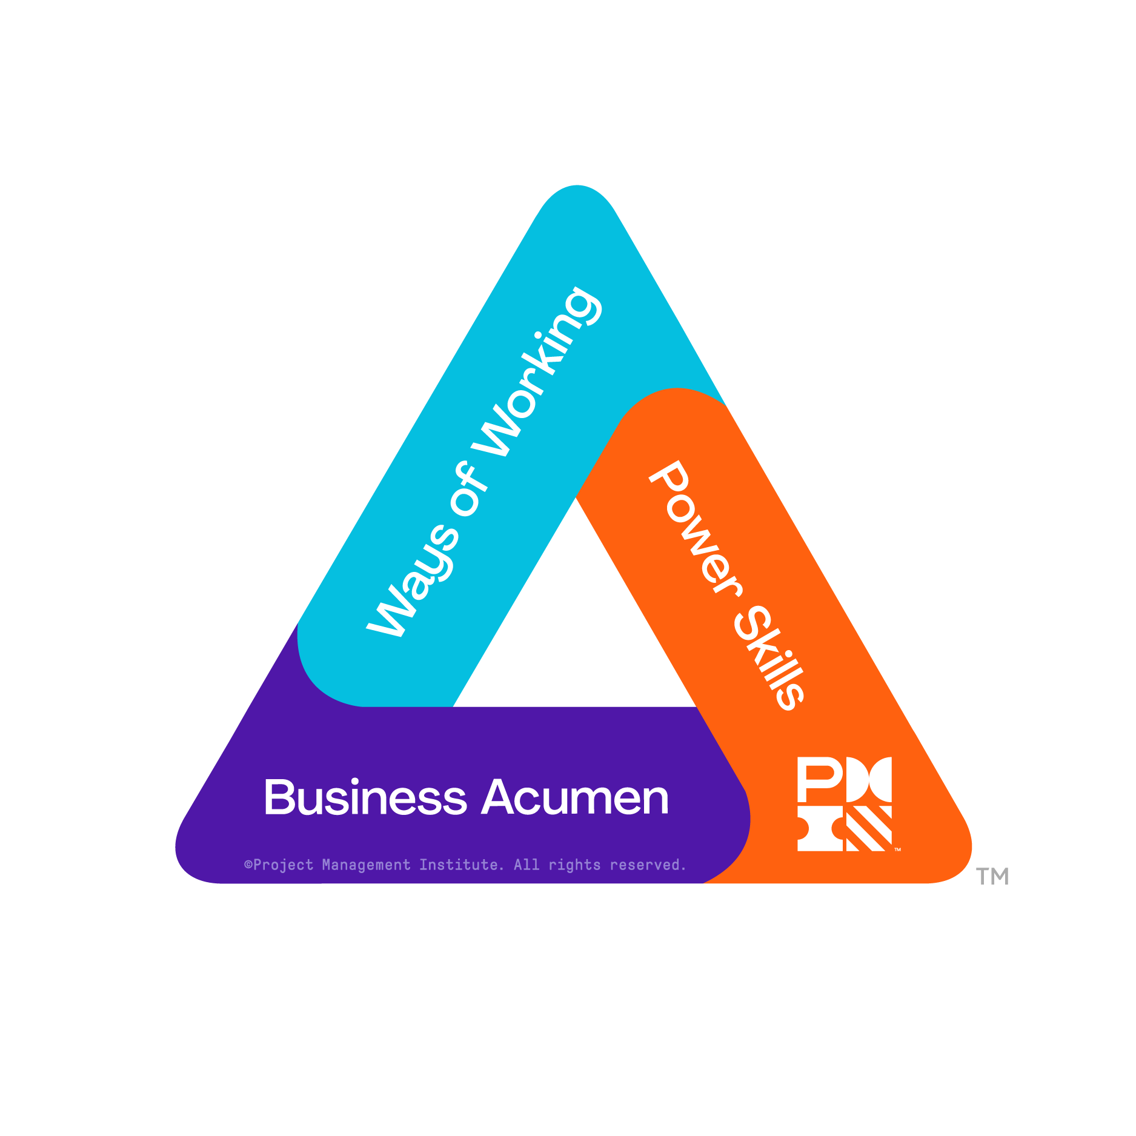
Why is this
update important?
As we expand the reach of PMI beyond our original core audience of those who describe themselves as project, program and portfolio managers, we are also seeking to reach a wide variety of professionals and changemakers who can benefit from building skills and making connections through PMI.
The changes to the PMI Talent Triangle will help professionals to navigate our offerings and build a skillset inclusive of different disciplines and practices, as well as other in-demand skills.

Slide 10

How will this change affect PMI certification holders?
In addition to the PMI Talent Triangle being a visual representation of the combination of skillsets that project professionals need, it also represents the Educational Requirements for earning PDUs to maintain PMI certifications. Equal numbers of PDUs are required in all three categories, to help build well-rounded experience.
The labels on the sides of the Talent Triangle are changing, but the criteria for earning PDUs is not. Credential holders need to be aware of the changes to the side labels for PDU reporting purposes, but they do not need to take any specific actions. The category names for PDU opportunities will be automatically changing in their MyPMI account. This will not require any action or impact the number of PDUs they have earned or the number they are required to earn to maintain their certifications.

Slide 11
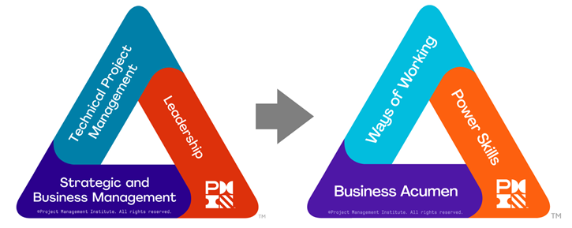
How will this change affect PMI chapters?
PMI will be updating all courses in the Course Catalog to align PDUs to the new side labels of the Talent Triangle during Q2-Q3 2022. No action will be needed on the chapter’s part to make these updates.
Any mentions of the Talent Triangle on your chapter website should be reviewed and updated if needed. All updated Talent Triangle images and assets are now available on the Marketing Portal.
See our Talent Triangle information page on PMI.org for FAQs and other details.

